Slide 2
Office 365 Developer On Ramp (Part 1)
Scot Hillier
Scot Hillier Technical Solutions, LLC
scot@scothillier.net
@ScotHillier

Slide 3









Scot Hillier
scot@scothillier.net
@ScotHillier

Slide 4
Agenda
Enterprise JavaScript
JavaScript Best Practices
TypeScript
HTML5 & CSS3
Enterprise Services Architecture
REST and OData
jQuery ajax and Promises
Web API
Enterprise Frameworks
Model-View-Controller with Angular

Slide 5
Enterprise JavaScript
JavaScript Best Practices

Slide 6
Key Concept: JavaScript is Object Based
An object is a set of key-value pairs…
var emptyObject = {};
var person = { firstName: "Scot", lastName: "Hillier" };
…which can be accessed using dot notation
alert(person.lastname);
…and can have values assigned dynamically
person.middleName = "Patrick";
Functions are also objects…
var myfunc = function(){};
…and can return objects.
var person = function(fn, ln) { return { firstName: fn, lastName: ln}; }();
The Browser DOM is a collection of objects
window.document
Notes:
We’ve all written some JavaScript, but how good was it?
What does it mean to be “object based”?
Do you really know what JavaScript is?

Slide 7
Enterprise JavaScript Best Practices
Use “strict” mode
Avoid coercive equality operators
Encapsulate your code
Minify and bundle libraries

Slide 8
Use Strict Mode
Declared with "use strict";
Cannot use a variable without declaring it
Cannot write to a read-only property
Cannot add properties to non-extensible objects
Cannot illegally delete functions and variables
Cannot define a property more than once in an object literal
Cannot use a parameter name more than once in a function
Cannot use reserved words, eval, or arguments, as names for functions and variables
The value of this in a function is no longer the window object
Cannot declare functions inside of statements
Cannot change the members of the arguments array

Slide 9
Avoid coercive equality operators
==, != are coercive
===, !== are not coercive
0 == '0'; //true
0 === '0'; //false
false == '0'; //true
false === '0'; //false

Slide 10
Encapsulate Your Code
Singleton Pattern
Revealing Module Pattern
Prototype Pattern

Slide 11
Using the Singleton Pattern
var Wingtip = window.Wingtip || {};
Wingtip.Customer = {
name: "Brian Cox",
speak: function() {
alert("My name is " + this.name);
}
};
Wingtip.Customer.speak();

Slide 12
Using the Revealing Module Pattern
var Wingtip = window.Wingtip || {};
Wingtip.Module = Wingtip.Module || {};
Wingtip.Module.Customer = function () {
//private members
var name,
setname = function (n) { name = n; },
getname = function () { return name; },
talk = function () { alert("My name is " + name); };
//public interface
return {
set_name: setname,
get_name: getname,
speak: talk
}
}();

Slide 13
Using the Prototype Pattern
window.Wingtip = window.Wingtip || {};
Wingtip.Customer = function (n) {
this.name = n
};
Wingtip.Customer.prototype = {
get_name: function() { return this.name; },
set_name: function(n) { this.name = n; },
speak: function() { alert("My name is " + this.name); }
};
var customer = new Wingtip.Customer("Brian Cox");
Customer.speak();

Slide 14
Minify and Bundle Libraries
Minification
Removes unnecessary characters and white space to minimize the size of the library
Bundling
Groups multiple libraries into a single library because it is more efficient to make one larger request than multiple small requests.
Make use of the “Web Essentials” add-in for Visual Studio

Slide 15
DEMO
JavaScript Best Practices
Notes:
E:\Demos\Intro to Apps\Hello World
Start a new SharePoint-Hosted app
Remove all starter code
Build the following using custom snippets
var Namespace = window.Namespace || {};
Namespace.Module = function () {
"use strict";
var val,
get_value = function () { return val; },
set_value = function (v) { val = v; };
return {
get_value: get_value,
set_value: set_value
};
}();
(function () {
"use strict";
jQuery(function () {
Namespace.Module.set_value("Hello, World!");
jQuery("#message").text(Namespace.Module.get_value());
});
}());

Slide 16
Enterprise JavaScript
TypeScript

Slide 17
Introduction to TypeScript
Typed superset of JavaScript that compiles to plain JavaScript
You write .ts files and it compiles to .js files
Cross-browser compatible
Integrated into Visual Studio 2013
Compilation
Intellisense
Key Features
Static typing
Classes, constructors, properties, methods
Modules
Interfaces

Slide 18
Static Typing
private getQueryStringParameter(p: string): string { ... };
scope
Input type
Return type
private displayName: string = "Scot";
scope
type

Slide 19
Classes
class Welcome {
//private members
private displayName: string = "Scot Hillier";
private pictureUrl: string = "/images/sh.jpg";
//public methods
public get_viewModel()
return {
"pictureUrl": Welcome.pictureUrl,
"displayName": Welcome.displayName
};
}
}

Slide 20
Modules
module Wingtip { … }

Slide 21
Interfaces
module Wingtip { //Namespace
interface WelcomeData {
pictureUrl: string;
displayName: string;
}
export class Welcome {
public get_viewModel(): WelcomeData {
return {
"pictureUrl": Welcome.pictureUrl,
"displayName": Welcome.displayName
};
}
}
Define Interface
Implement Interface

Slide 22
DEMO
TypeScript 101
Notes:
1. Create a new SharePoint-hosted app
2. Delete App.js
3. Right-click Scripts folder Add>>New item
4. Search Installed Templates >> TypeScript
5. Select TypeScript file
6. Change name to App.ts, click Add
7. Save project
8. Unload Project
9. Edit csproj file
10. Locate the ItemGroup containing the ts file you added
<ItemGroup>
<TypeScriptCompile Include="Scripts\App.ts" />
</ItemGroup>
11. Update this section to include indicate the compile target
[SNIPPET IN TOOLBOX]
<ItemGroup>
<TypeScriptCompile Include="Scripts\App.ts" />
<Content Include="Scripts\App.js">
<DependentUpon>App.ts</DependentUpon>
</Content>
</ItemGroup>
12. Add the following immediately before the </Project> tag
[SNIPPET IN TOOLBOX]
<PropertyGroup Condition="'$(Configuration)' == 'Debug'">
<TypeScriptTarget>ES5</TypeScriptTarget>
<TypeScriptRemoveComments>false</TypeScriptRemoveComments>
<TypeScriptSourceMap>true</TypeScriptSourceMap>
<TypeScriptModuleKind>AMD</TypeScriptModuleKind>
</PropertyGroup>
<PropertyGroup Condition="'$(Configuration)' == 'Release'">
<TypeScriptTarget>ES5</TypeScriptTarget>
<TypeScriptRemoveComments>true</TypeScriptRemoveComments>
<TypeScriptSourceMap>false</TypeScriptSourceMap>
<TypeScriptModuleKind>AMD</TypeScriptModuleKind>
</PropertyGroup>
<Import Project="$(VSToolsPath)\TypeScript\Microsoft.TypeScript.targets" />
17. Save your changes
18. Reload the project
19. Build the project
20. Change the deployment type of App.js to ElementFile
21. Use the TypeScript snippets in the toolbox to build the demo

Slide 23
Enterprise JavaScript
HTML5 and CSS3

Slide 24
What’s included?
Semantic Markup
New style capabilities
New JavaScript APIs

Slide 25
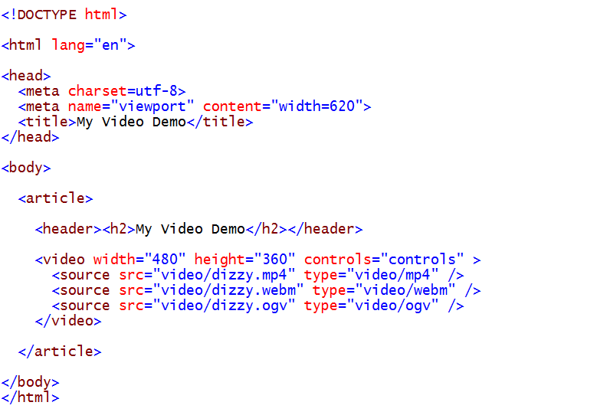
A Simple HTML5 Page
A new simpler DOCTYPE
A new semantic element
A new functional element

Slide 26
New HTML5 Semantic Tags
<header>
<nav>
<section>
<article>
<figure>
<dialog>
<aside>
<hgroup>
<time>
<footer>
<header></header>
<nav></nav>
<article>
<section>
<h2></h2>
<p></p>
<p></p>
</section>
<section>
<h3></h3>
<p></p>
</section>
</article>
<aside>
<section>
</section>
</aside>
<footer></footer>

Slide 27
Which Browsers Support HTML5 Elements
Browser support for HTML5 Elements
Internet Explorer 9 & 10
Firefox 7 and higher
Chrome 14 and higher
Safari 5 and higher
Opera 11 and higher
Mobile Safari 3.2 and higher
Opera Mobile 5 and higher
Android 2.1 and higher

Slide 28
CSS3 Changes
CSS3 Adds Many New CSS Properties
Borders can have rounded corners
Element can have multiple backgrounds with greater placement precision
Colors can be expressed with gradients and opacity
Text can have drop shadows and more control over text wrap
Partial adoption of new properties has been going on for years
Some browsers support new properties using proprietary prefixes
-ms- Internet Explorer (Trident )
-webkit- Google, Chrome & Safari (Gecko)
-moz- Firefox (Mozilla)
-o- Opera (Presto)

Slide 29
New JavaScript 5 APIs
New JavaScript APIs
Canvas
Drag and Drop
History
In-line Editing
Messaging
Offline Apps
Video and Audio
Geolocation
Local Storage
Selectors
Server Events
Web Sockets
Workers
MIME Type / Protocol Handlers Registration

Slide 30
DEMO
HTML5
Notes:
dev.wingtip.com/html5/detect capabilities app
Just a quick tour of capabilities
E:\Demos\HTML5 and JavaScript\detectcapabilities
Show modernizr
dev.wingtip.com/html5/HTML5 Contacts App
Show semantic elements
Add a contact to show new form elements
dev.wingtip.com/html5/Paint
Showing canvas
dev.wingtip.com/html5/WeatherBug (USE CHROME)
Geolocation

Slide 31
Enterprise Services Architecture
REST and OData

Slide 32
Representational State Transfer
In the beginning there was SOAP
XML-based protocol for executing web service operations
SOAP = Simple Object Access Protocol
SOAP makes simple things more complicated than they could be
Acronym status of SOAP revoked in 2003
REST is simpler and much easier to use
REST = REpresentational State Transfer
Simple approach based on HTTP request/response pairs
HTTP requests target specific resources using unique URIs
Resources move back and forth using representations
Representations of resources defined using Internet Media Types

Slide 33
REST Constraints
Client-Server
Client pulls representations from the server
Separation of concerns
Stateless
Client provides all necessary context
Server returns all necessary state
Cache
Responses indicate whether or not they can be cached
eTag, Date, Expires headers
Interface
Resources are accessible through URIs
Resources operations are through HTTP verbs
The same representations can be used for all operations
Resources are interconnected to allow linking
Layered
Resources are unaffected by proxy servers, gateways, etc.

Slide 34
RESTful Web Services
RESTful Web Service
implemented using the principles of REST
REST URI = [base URI] + [resource path] + [query options]
Calls based on standard HTTP verbs (GET, POST, PUT, DELETE)
Passes data to and from client using representations
Can be designed to implement custom APIs and/or standard APIs
Data passed across network using representations
Representations model resources – but they’re different
Based on common formats: HTML, XML, ATOM and JSON
Based on specific Internet media types

Slide 35
Internet Media Types
Internet media type defines format of representation
Commonly referred to as Content Types previous known as MIME types
Examples of common Internet media types
text/html
text/xml
application/xml
application/atom+xml
application/json
HTTP headers used to indicate Internet Media Type
ACCEPT request header indicates what client wants in response
Content-Type header indicates type of request/response body

Slide 36
Open Data Protocol (OData)
Standardized REST API for CRUD operations
Standardized Data Types
Standardized URI format
<Property Name="Id" Type="Edm.Guid" Nullable="false"/>
<Property Name="Title" Type="Edm.String"/>
<Property Name="TreeViewEnabled" Type="Edm.Boolean" Nullable="false"/>
<Property Name="UIVersion" Type="Edm.Int32" Nullable="false"/>

Slide 37
OData Entity Model
Service Document
$metadata
Entity Types define entities
Entity Key defines unique property
Associations link entities together
<EntityType Name="Site">
<EntityType Name="Web" BaseType="SP.SecurableObject">
<EntityType Name="List" BaseType="SP.SecurableObject">
<EntityType Name="ListItem" BaseType="SP.SecurableObject" OpenType="true">
<Key><PropertyRef Name="Id"/></Key>
<NavigationProperty Name="RootWeb" …

Slide 38
OData Query Options
$select
$filter
$orderby
$top
$skip
$expand

Slide 39
DEMO
REST
Notes:
Just using the browser…
If possible, start with https://shillier.sharepoint.com/_api/$metadata Otherwise E:\Demos\Web Services\metadata.edmx
Show EntityType Name=“Site” explain how this is the API definition
Show RootWeb relationship
Now Show EntityType Name=“Web”
Show Lists
Now navigate to _api/site/rootWeb/lists to show how it works

Slide 40
Enterprise Services Architecture
jQuery ajax and Promises

Slide 41
AJAX Request
var xmlhttp = new XMLHttpRequest();
xmlhttp.onreadystatechange = function () {
if (xmlhttp.readyState === 4 && xmlhttp.status === 200) {
var results = JSON.parse(xmlhttp.responseText).d.results;
for (var i = 0; i < results.length; i++) {
var title = results[i].Title;
}
};
var url = "../_api/web/lists/getByTitle('Contacts')/items?$select=Title&$orderby=Title";
xmlhttp.open("GET", url, false);
xmlhttp.setRequestHeader("accept", "application/json;odata=verbose");
xmlhttp.send();

Slide 42
jQuery AJAX Request
<script src="../Scripts/release/jquery-1.6.2.min.js"></script>
jQuery.ajax(
{
url: "../_api/web/lists/getByTitle('Contacts')/items?$select=Title&$orderby=Title",
type: "GET",
headers: {
"accept": "application/json;odata=verbose",
},
success: function (data, status, jqXHR) {},
error: function (jqXHR, status, message) {}
}
);
jqXHR is a superset of XMLHttpRequest
status is a string
message is a string
data is a JSON object

Slide 43
Adding Items to a SharePoint List
jQuery.ajax({
url: "../_api/web/lists/getByTitle('Contacts')/items",
type: "POST",
contentType: "application/json;odata=verbose",
data: JSON.stringify(
{
'__metadata': {
'type': 'SP.Data.ContactsListItem'
},
'Title': lname,
'FirstName': fname,
'WorkPhone': wphone,
'Email': email
}),
headers: {
"accept": "application/json;odata=verbose",
"X-RequestDigest": jQuery("#__REQUESTDIGEST").val()
},
success: function (data, status, jqXHR) {},
error: function (jqXHR, status, message) {}
});
Type Metadata
Request Digest

Slide 44
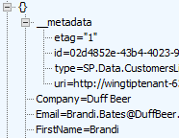

ETags and Optimistic Concurrency
OData v2 requires items to carry ETags
ETag is integer value in that it identities version of item
ETag is automatically incremented with each update
ETag use to support for optimistic concurrency control
ETag works to eliminate the “lost update” scenario
ETag must be tracked in order to post updates in most scenarios

Slide 45
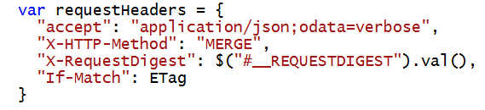
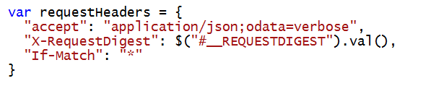
ETags and the If-Match Header
Update and Delete operations require If-Match Header
Allows you to pass ETag value during an update
Update fails if ETag value changed due to update by other user
You can pass wildcard (*) value inside If-Match Header
Done to disable optimistic concurrency control
This is commonly done with delete operations

Slide 46
Updating a SharePoint List Item
jQuery.ajax({
url: "../_api/web/lists/getByTitle('Contacts')/items(" + Id + ")",
type: "POST",
contentType: "application/json;odata=verbose",
data: JSON.stringify(
{
'__metadata': {
'type': 'SP.Data.ContactsListItem'
},
'FirstName': fname
}),
headers: {
"accept": "application/json;odata=verbose",
"X-HTTP-Method": "MERGE",
"X-RequestDigest": jQuery("#__REQUESTDIGEST").val(),
"If-Match": eTag
},
success: function (data, status, jqXHR) {},
error: function (jqXHR, status, message) {}
});
Type Metadata
eTag

Slide 47
Deleting a SharePoint List Item
jQuery.ajax({
url: "../_api/web/lists/getByTitle('Contacts')/items(" + Id + ")",
type: "DELETE",
headers: {
"accept": "application/json;odata=verbose",
"X-RequestDigest": jQuery("#__REQUESTDIGEST").val(),
"If-Match": "*"
},
success: function (data, status, jqXHR) {},
error: function (jqXHR, status, message) {}
});
DELETE operation
eTag

Slide 48
Promises
Property of a jQuery “Deferred”
Automatically returned from jQuery ajax method
Callbacks include jqXHR object, which contains promise
Allow for Orchestration of multiple calls
Sequence calls
Batch calls

Slide 49
Promises
function myPromise() {
var deferred = $.Deferred();
setTimeout(function() {
deferred.resolve("success!");
}, 1000);
return deferred.promise();
}
myPromise().then(
function(value) {
alert(value);
},
function() {
alert("error!");
}
);
1
Create a Deferred
3
Resolve or Reject
2
Return the Promise
Success
Failure

Slide 50
DEMO
Promises
Notes:
Open E:\Demos\CSOM and REST\Promises
Walk code in detail
Run demo

Slide 51
Enterprise Services Architecture
Web API

Slide 52
Introducing WebAPI
Part of ASP.NET MVC
Use the same Controller and Routing paradigm
Simplified creation of REST services
GET, POST, PUT, DELETE operations
JSON, XML returned
Can be a stand-alone service or part of an app
Supports using Entity Framework to wrap database calls

Slide 53
Controllers
public class CustomersController : EntitySetController<Customer,int>
{
List<Customer> customers = new List<Customer>()
{
new Customer() { Id=1, LastName="Doyle", FirstName="Patricia" },
new Customer() { Id=2, LastName="Burke", FirstName="Brian" }
};
[Queryable]
public override IQueryable<Customer> Get()
{
return customers.AsQueryable();
}
protected override Customer GetEntityByKey(int Id)
{
return (from c in customers where c.Id==Id select c).FirstOrDefault();
}
}

Slide 54
Routes
ODataModelBuilder builder = new ODataConventionModelBuilder();
builder.EntitySet<Customer>("Customers");
IEdmModel model = builder.GetEdmModel();
config.Routes.MapODataRoute("CustomersRoute", "odata", model);

Slide 55
Consuming Web API
$.ajax(
{
url: "http://webs.wingtip.com/SimpleOdata/odata/Customers(" + id + ")",
type: "GET",
headers: {
"accept": "application/json;odata=verbose",
},
success: onSuccess,
error: onError
}
);
Beware of cross-origin calls!

Slide 56
DEMO
WebAPI2
Notes:
Make the default “values” controller
Then run this with Fiddler open
E:\Demos\Web Services\SimpleODATA
THE SERVICE IS ALREADY DEPLOYED SO THE CLIENT IN THE WEB SERVICES SITE WORKS

Slide 57
Enterprise Frameworks
Model-View-Controller

Slide 58
Model-View-Controller
View
Controller
Data
Model

Slide 59
Introducing Angular
MVC Framework written entirely in JavaScript
Utilizes “Modules” to define scope
“Injects” scope into Controllers to maintain context
“Scope” is used to create and maintain the View
“Services” and “Directives” provide app-wide functionality
View is bound declaratively to HTML

Slide 60
Angular Framework
Module
Routes
View
$scope
Controller
Directives
Factory

Slide 61
Model-View-Controller with Angular
View
Controller
Data
$scope
$scope

Slide 62
Directives
Utilizes HTML5 custom data attributes
Allows for the addition of custom attributes starting with data-
Angular uses directives for declarative programming
Angular directives start with “ng-”
data-ng-app, defines scope of the framework
data-ng-controller, invokes a controller
data-ng-click, handles click event

Slide 63
Modules
A container for the components of the app
//module
var myapp = angular.module("MyApp", []);
<!-- html -->
<div data-ng-app = "MyApp">

Slide 64
Controllers
Build up the $scope (a.k.a, View Model)
//controller
myapp.controller("welcomeCtrl", ["$scope",
function welcomeCtrl($scope) {
//model
$scope.welcomeMessage = "Hi";
}
);
<!-- html -->
<div data-ng-controller="welcomeCtrl">

Slide 65
View Binding
Bind the $scope to the HTML elements
<div ng-app="App">
<div ng-controller="welcomeCtrl">
<h3>{{welcomeMessage}}</h3>
</div>
</div>

Slide 66
DEMO
MVC with Angular
Notes:
E:\Demos\HTML and JavaScript\3rdPartyLibraries.sln
Open E:\Demos\HTML and JavaScript\3rdPartyLibraries.sln
Explain the project structure and what’s in each folder
App Start\App.js for module definition
wingtip.controllers.welcome for our first look at a controller
Default.aspx for view binding
wingtip.controllers.contacts for a look at events from the user
wingtip.services.toastr for a service

Slide 67
Summary
Enterprise JavaScript
JavaScript Best Practices
TypeScript
HTML5 & CSS3
Enterprise Services Architecture
REST and OData
jQuery ajax and Promises
Web API
Enterprise Frameworks
Model-View-Controller with Angular

Slide 69
ATTENTION: PLEASE READ
Photography and copyright infringement.
Using imagery from movies, television, music and pop-culture is illegal, unless purchased, licensed or by express written consent from the owner. Please do not include unlicensed imagery in your presentation.
Sessions with questionable imagery will not be published until resolved. The speaker will be contacted via email for immediate resolution. If additional costs are incurred in editing, an I/O Code will be required.
If you have any questions regarding your imagery please contact
Media Acquisitions Inquiries: mediaacq@microsoft.com.
The PPT deck and Recording will not be published until the editing is complete.

Slide 70
If an image is on the Internet/Bing it is in the public domain.
If there is no copyright notice on the image, I don’t need permission.
If I don’t profit from the use, I don’t need permission.
If I remove the image after notice, I don’t owe any money to the copyright.
If I alter the image X%, I don’t need permission.
If I only use a part of the image, I don’t need permission.
If I only include a hyperlink in my presentation and click it to show the image, I don’t need permission.
Common Copyright Myths

Slide 71
Resources for Microsoft employees
Can’t find the image that you have in mind for your presentation? The Media Acquisitions team can help you find and license imagery through our stock photography providers. You will also find imagery and information via these links:
Mediaacq
Microsoft Brand Tools
Presentation guidelines
Microsoft photography
Microsoft illustrations
www.superstock.com/
www.gettyimages.com/creativeimages/royaltyfree
www.corbisimages.com/stock-photo/royalty-free
(Media Acquisitions alias)
There are agreements in place with these providers.
For information on the use of third-party copyrighted content: http://lcaweb/CTP/Copyrights/Third-Party-Content-Use/Pages/default.aspx

Slide 72
Preferred text layout (no bullets)
Main topic 1: size 40pt
Size 20pt for the subtopics
Size 20pt for the subtopics
Main topic 2: size 40pt
Size 20pt for the subtopics
Size 20pt for the subtopics
Main topic 3: size 40pt
Size 20pt for the subtopics
Size 20pt for the subtopics

Slide 73
Preferred text layout (no bullets)
Main topic 1: size 40pt
Size 20pt for the subtopics
Size 20pt for the subtopics
Main topic 2: size 40pt
Size 20pt for the subtopics
Size 20pt for the subtopics
Main topic 3: size 40pt
Size 20pt for the subtopics
Size 20pt for the subtopics

Slide 74
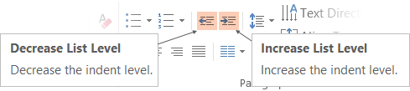
Adjusting list levels
Main topic 1: size 40pt
Size 20pt for the subtopics
Size 20pt for the subtopics
Main topic 2: size 40pt
Size 20pt for the subtopics
Size 20pt for the subtopics
Main topic 3: size 40pt
Size 20pt for the subtopics
Size 20pt for the subtopics
Use the “Decrease List Level” and “Increase List Level” tools on the Home Menu to change text levels.
Try this:
Place your cursor in any row of text to the left that says “Size 20pt for subtopics”
Next click the Home tab, and then on the “Decrease List level” tool. Notice how the line moves up one level.
Now try placing your cursor in one of the “Main topic…” lines of text. Click the “Increase List Level” tool and see how the text is pushed in one level
Use these 2 tools to adjust your text levels as you work

Slide 75
Bullet points layout with subtitle Subtitle
Example of a bulleted slide with a subhead
Set the slide title to “Sentence case”
Set subheads to “Sentence case”
Hyperlink style
www.microsoft.com

Slide 76
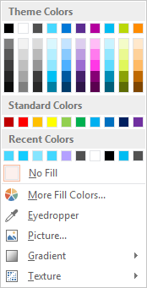
Slide palette info
The PowerPoint palette for this template has been built for you and is shown below. Avoid using too many colors in your presentation.
Accent colors 1-6 – (6 Theme Colors to the far right)
Text
Light 2
Accent 1
Accent 2
Accent 3
Accent 4
Accent 5
Accent 6
Use Accent 1 as the main accent color. Use Accent 2 and Accent 3 when additional colors are needed.
Use Accents 4-6 sparingly – only when more colors are necessary.

Slide 77
Video

Slide 78
Demo
Speaker name

Slide 79
Photo layout 1

Slide 80

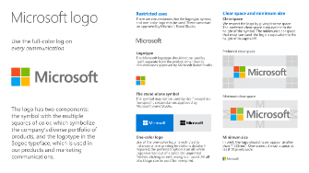

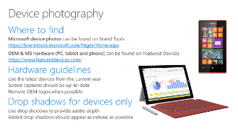
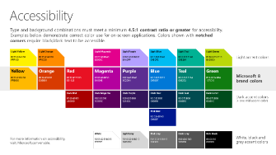
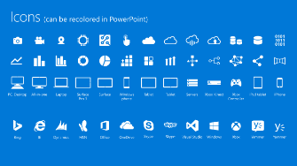
Microsoft brand guidelines
Looking for more slide resources?
Brand guidelines for PowerPoint templates is a separate slide deck that provides an overview of the Microsoft brand, guidelines, resources, tips and much more.
A few of the slides are shown at right.
Download from: https://brandtools.microsoft.com/Resources/Presentations/Pages/StoryBoard.aspx?section=Elements1

Slide 81
Section title

Slide 82
Section title

Slide 83
Section title

Slide 84
Section title

Slide 85
Section title

Slide 86
Software code slide
This slide layout uses Consolas, a monotype font which is ideal for showing software code.

Slide 87
Notes (hidden)
Some speakers at Microsoft like to use this slide for hidden “notes slides”.
Delete it if you don’t want to use it.
NEXT: <next slide title>

